Slide 1
PES BOYS HOSTEL
WEB FRAMEWORKS PROJECT (UE17CS257A)

Slide 2
DESCRIPTION
THE PES Boys Hostel website is a website that bridges the gap between Hostel management authorities and students.
It gives a brief introduction about the accommodation facilities in the hostel and the rules and regulations students must adhere to.
It provides information about the hostel fee structure: associated rent and mess charges as well as other relevant details.
New students can register on the website for future allotments.
Logged in users can access as well as edit their details in the database on the website.

Slide 3
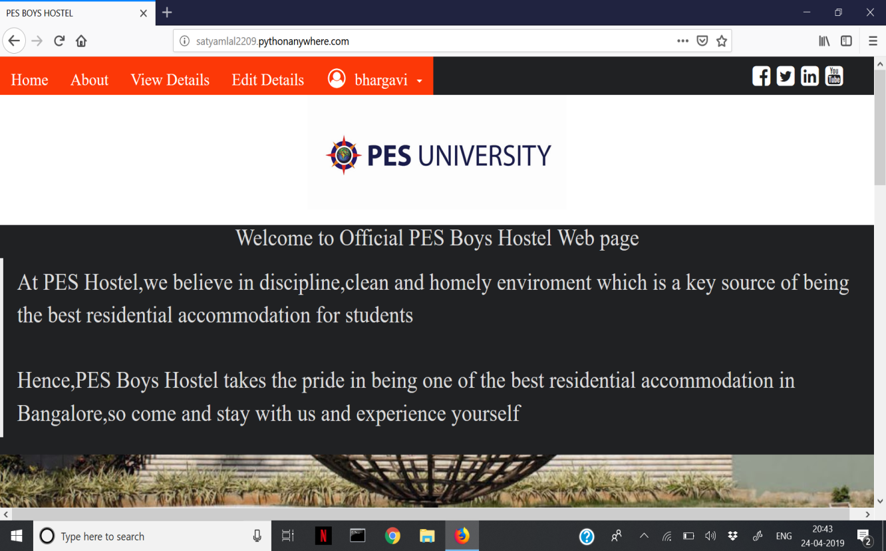
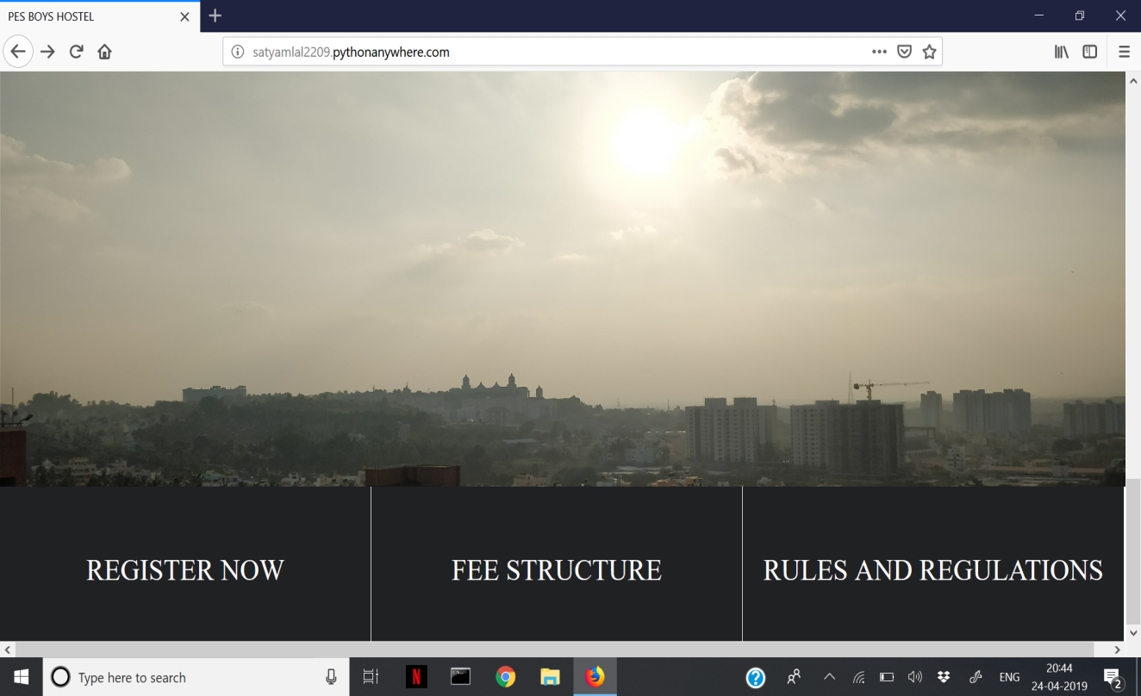
SCREENSHOTS OF THE WEBSITE

Slide 4
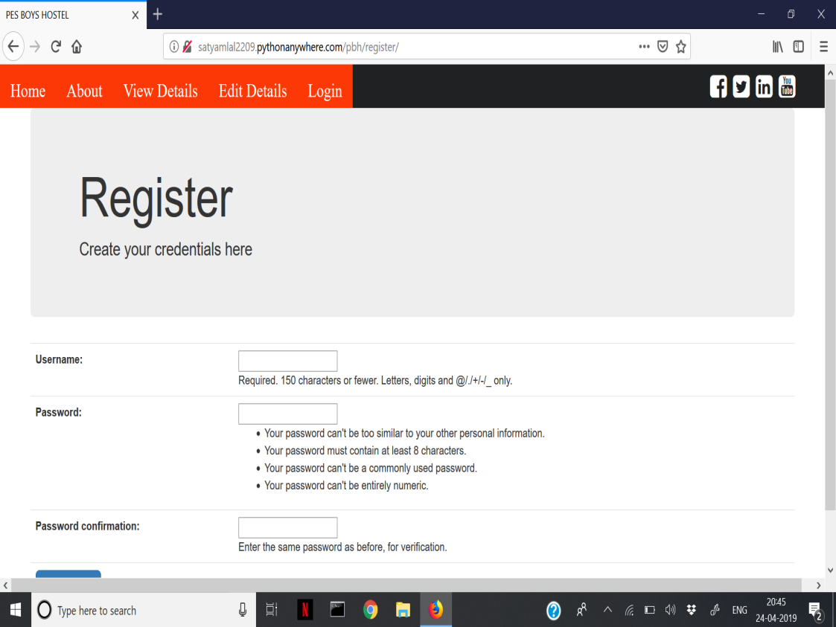
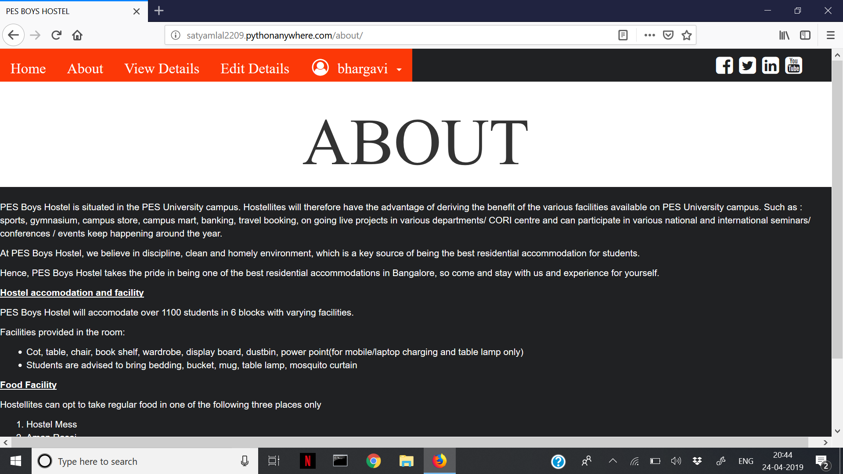
SCREENSHOTS

Slide 5
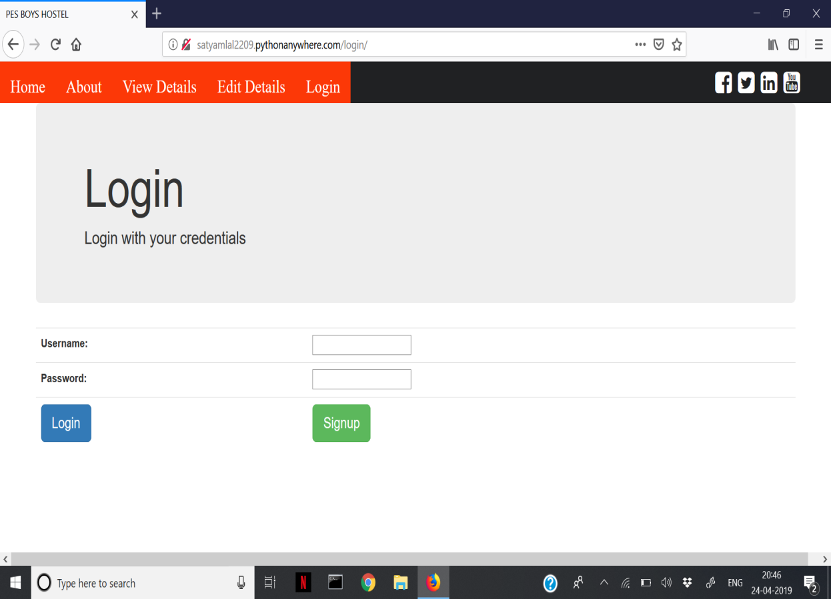
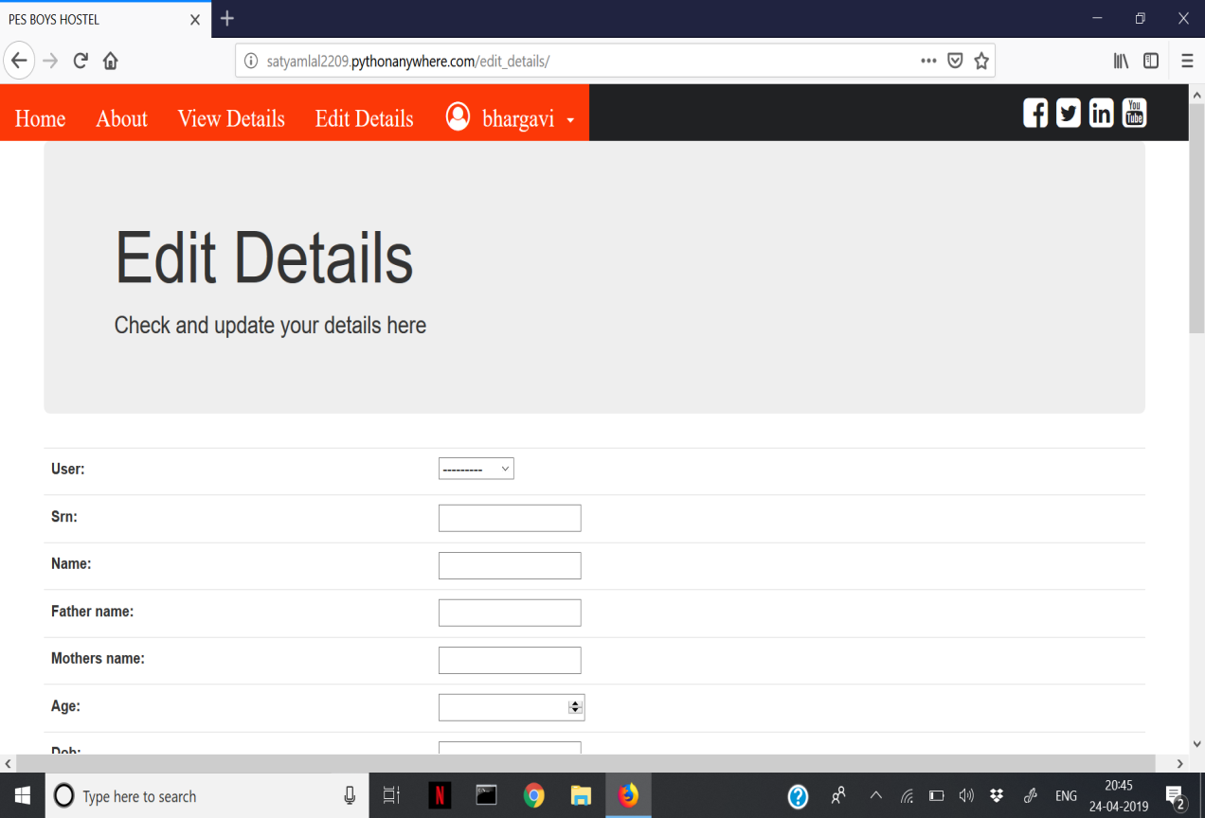
SCREENSHOTS

Slide 6
LINK TO LOCATION WHERE WEBSITE IS HOSTED
LINK TO ORIGINAL WEBSITE
https://ishar-menon.github.io/main.html
LINK TO WEBSITE HOSTED ON PYTHONANYWHERE
http://bhargavikumar13.pythonanywhere.com/

Slide 7
CONTRIBUTIONS
Satyam Lal
Satyam has implemented the Model and parts of the View of the Model View Template. He has also designed the Forms with Bootstrap.
Bhargavi Kumar
Bhargavi has implemented the Templates, parts of the View and handles URL redirection and maintained the sync between frontend and backend.

Slide 8
TAKEAWAYS
The major takeaway from building this project has been that Web Frameworks add a lot of ease and convenience to implementing and authoring websites that also have a database.
Implementing such a website would have been a tedious and cumbersome task if we were to only use HTML, CSS, JavaScript and PHP.
It also eliminates the need to write SQL Queries manually.

Slide 9
CHALLENGES
Maintaining sync between frontend and backend.
Modifying inbuilt form fields using CSS and Bootstrap.
Saving the templates and static folders in appropriate folders and providing the correct paths for the same.

Slide 10
CONTACT INFORMATION
Satyam Shreevikas Lal
PES1201701802
vasulal22@gmail.com
Bhargavi Priyasha Kumar
PES1201701802
bhargavikumar13@gmail.com

